Slide 1
CAPSULEFY
Your past, your present and your future

Slide 2
Overview
Idea
Team
Technologies
Planification
Demo
Competitors
Piloting plan
Costs

Slide 3
IDEA
What is Capsulefy?

Slide 4





Time capsule

Slide 5


Deadman switch
ON

Slide 6
TEAM
Who is behind?

Slide 7
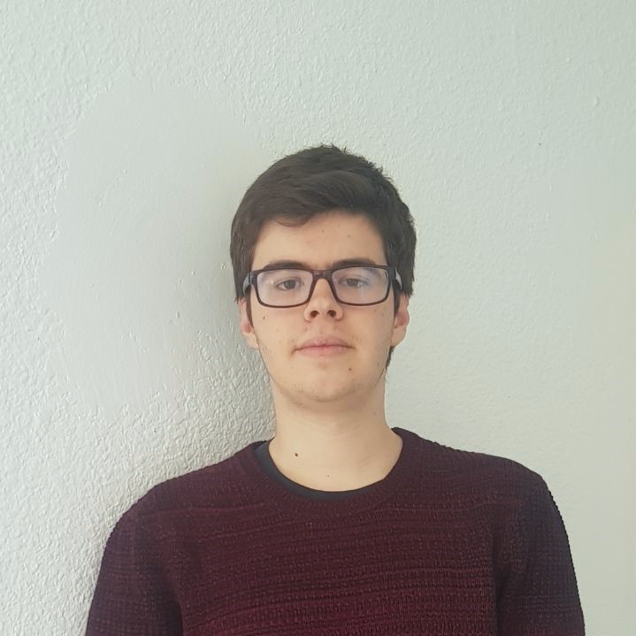










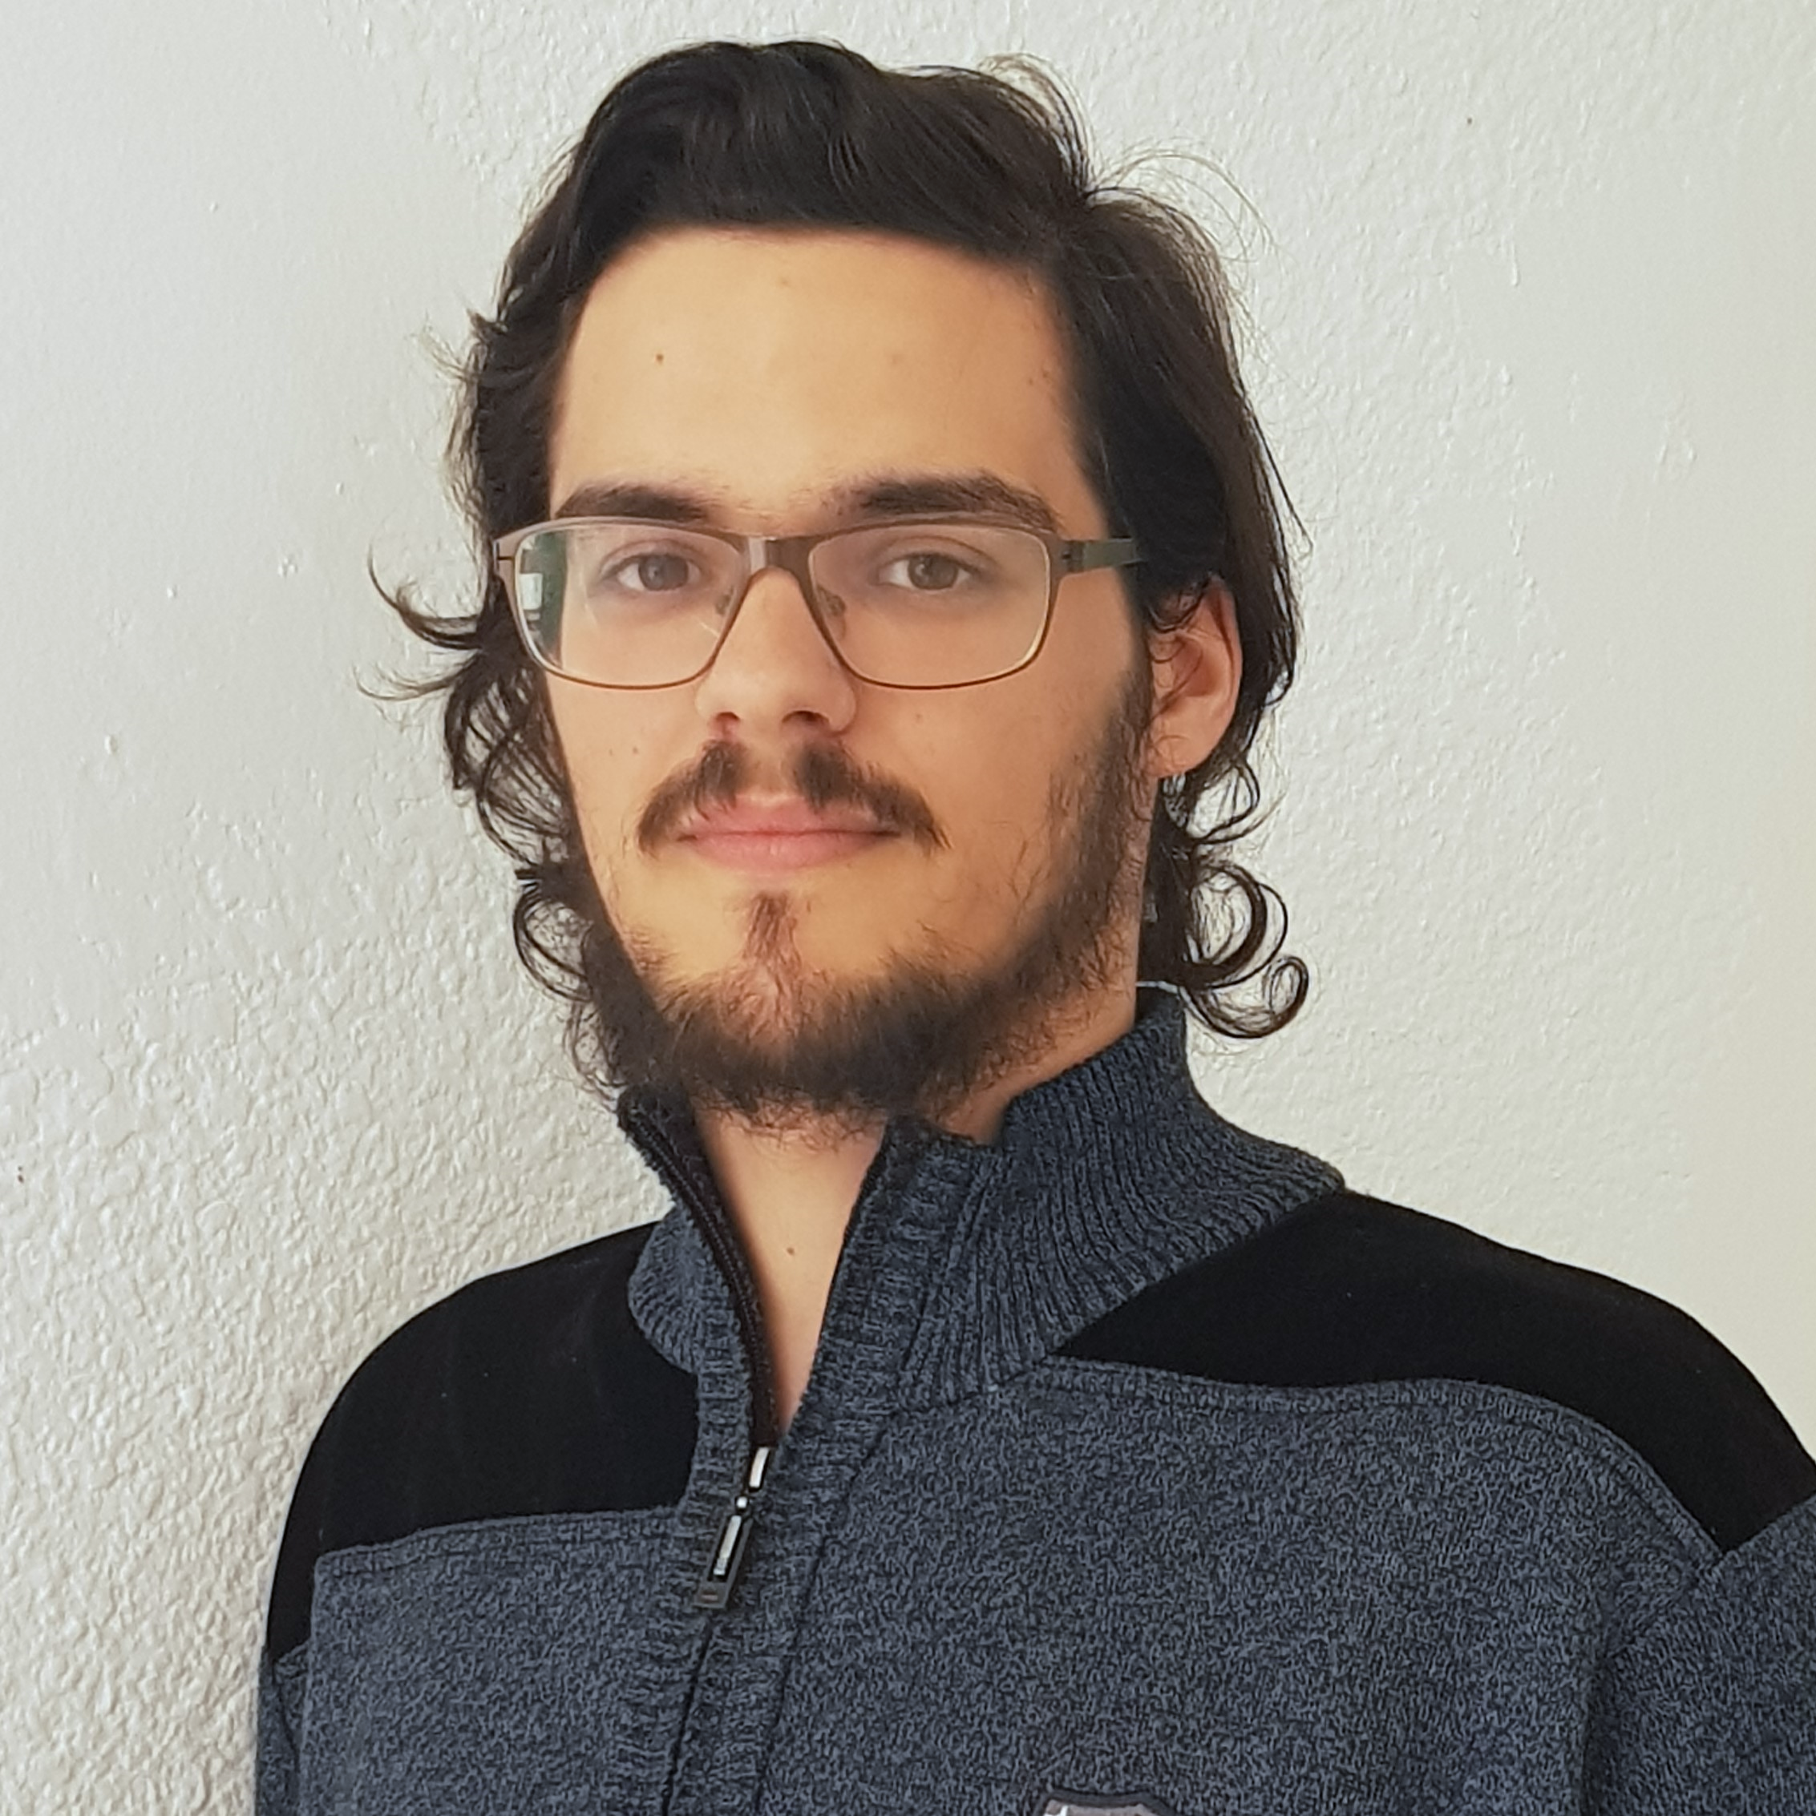



Pablo Rebollo
Project manager, backend developer
Juan Rodríguez
Requirements engineer, backend developer
Adrián Cantón
Business manager, full-stack developer
Rafael Fresno
Backend developer, API integration
Daniel Carpio
Analist,
frontend developer

Slide 8




Teamwork
Skills
Profitable work
Positive feedback

Slide 9



Performance indicator
$$avg(\frac{Total time}{Estimated time})$$
~
>= 0.5
< 0.8
>= 0.8
<= 1.2
> 1.2
<= 1.5
!
?
< 0.5
> 1.5

Slide 10



Optimistic estimation
Wasted time
Difficulties
Pesimistic estimation
Easier tasks

Slide 11
TECHNOLOGIES
What stack do we use?

Slide 12




Web app
Users and capsules
Media storage
Social networks

Slide 13


Testing
Functional and integration
Performance
Coverage

Slide 14





Slide 15
COMPETITORS
What makes us different?

Slide 16


 | Viajeros en el tiempo | Mytimecapsule | Miigen | thetimecapsule | Capsulefy
Automatic content publication
Free plan
Premium plan
Images
Videos
Social network integration
Deadman switch

Slide 17
COSTS
How much does it cost?

Slide 18


Realistic | 29968.20 – 31330.29 €
Optimistic | 28061.13 €
Pesimistic | 34054.77 €
Project duration: 4 months

Slide 19
Project duration | 4 months
Salaries | 20.80 €/hour
Hours per month | 40
Amortization | 60 months
Equipment | 306.67 €
Hosting (1 year) | 669.34 €
Advertising (6 months) | 3060 €
Risk prevention | 10% (2724.38 €)
Total | 29968.20 €

Slide 20

Monthly advertising costs
220 €
140 €
150 €

